Slide 1
Chapter 4
Memory

Slide 2
Overview
Basic memory circuits
Organization of the main memory
Cache memory concept
Virtual memory mechanism
Secondary storage

Slide 3
Characteristics
Location
Capacity
Unit of transfer
Access method
Performance
Physical type
Physical characteristics
Organisation

Slide 4
Location
CPU
Internal
External

Slide 5
Capacity
Word size
  The natural unit of organisation
Number of words
  or Bytes

Slide 6
Unit of Transfer
Internal
  Usually governed by data bus width
External
  Usually a block which is much larger than a word
Addressable unit
  Smallest location which can be uniquely addressed
  Word internally
  Cluster on M$ disks

Slide 7
Access Methods (1)
Sequential
  Start at the beginning and read through in order
  Access time depends on location of data and previous location
  e.g. tape
Direct
  Individual blocks have unique address
  Access is by jumping to vicinity plus sequential search
  Access time depends on location and previous location
  e.g. disk

Slide 8
Access Methods (2)
Random
  Individual addresses identify locations exactly
  Access time is independent of location or previous access
  e.g. RAM
Associative
  Data is located by a comparison with contents of a portion of the store
  Access time is independent of location or previous access
  e.g. cache

Slide 9
Performance
Access time
  Time between presenting the address and getting the valid data
Memory Cycle time
  Time may be required for the memory to “recover” before next access
  Cycle time is access + recovery
Transfer Rate
  Rate at which data can be moved

Slide 10
Physical Characteristics
Decay
Volatility
Erasable
Power consumption

Slide 11
Memory Hierarchy
Registers
  In CPU
Internal or Main memory
  May include one or more levels of cache
  “RAM”
External memory
  Backing store

Slide 12
Hierarchy List
Registers
L1 Cache
L2 Cache
Main memory
Disk cache
Disk
Optical
Tape

Slide 13

Memory Hierarchy - Diagram

Slide 14
Speed, Size, and Cost
Pr
ocessor
Re
gisters
Increasing
Increasing
Increasing
size
speed
cost per bit
Primary
L1
cache
Secondary
L2
cache
Main
memory
Magnetic disk
secondary
memory
Figure 5.13. Memory hierarchy.

Slide 15
The Bottom Line
How much?
  Capacity
How fast?
  Time is money
How expensive?

Slide 16
Types of External Memory
Magnetic Disk
  RAID
  Removable
Optical
  CD-ROM
  CD-Recordable (CD-R)
  CD-R/W
  DVD
Magnetic Tape

Slide 17
Magnetic Disk
Disk substrate coated with magnetizable material (iron oxide…rust)
Substrate used to be aluminium
Now glass
  Improved surface uniformity
    Increases reliability
  Reduction in surface defects
    Reduced read/write errors
  Lower flight heights (See later)
  Better stiffness
  Better shock/damage resistance

Slide 18
Floppy Disk
8”, 5.25”, 3.5”
Small capacity
  Up to 1.44Mbyte (2.88M never popular)
Slow
Universal
Cheap
Obsolete?

Slide 19
Optical Storage CD-ROM
Originally for audio
650Mbytes giving over 70 minutes audio
Polycarbonate coated with highly reflective coat, usually aluminium
Data stored as pits
Read by reflecting laser
Constant packing density
Constant linear velocity

Slide 20
Other Optical Storage
CD-Recordable (CD-R)
  WORM
  Now affordable
  Compatible with CD-ROM drives
CD-RW
  Erasable
  Getting cheaper
  Mostly CD-ROM drive compatible
  Phase change
    Material has two different reflectivities in different phase states

Slide 21
DVD - technology
Multi-layer
Very high capacity (4.7G per layer)
Full length movie on single disk
  Using MPEG compression
Finally standardized (honest!)
Movies carry regional coding
Players only play correct region films
Can be “fixed”

Slide 22
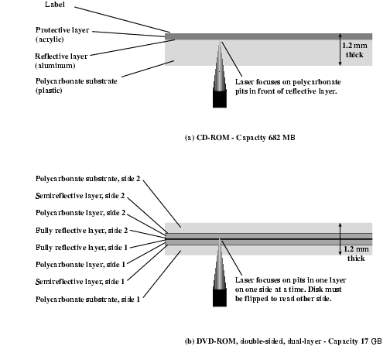
CD and DVD

Slide 23
Magnetic Tape
Serial access
Slow
Very cheap
Backup and archive

Slide 24
Digital Audio Tape (DAT)
Uses rotating head (like video)
High capacity on small tape
  4Gbyte uncompressed
  8Gbyte compressed
Backup of PC/network servers

Slide 25
Semiconductor Memory Types
Memory Type | Category | Erasure | Write Mechanism | Volatility
Random-access memory (RAM) | Read-write memory | Electrically, byte-level | Electrically | Volatile
Read-only memory (ROM) | Read-only memory | Not possible | Masks | Nonvolatile
Programmable ROM (PROM) |  |  | Electrically
Erasable PROM (EPROM) | Read-mostly memory | UV light, chip-level
Electrically Erasable PROM (EEPROM) |  | Electrically, byte-level
Flash memory |  | Electrically, block-level

Slide 26
Memory
Memory signals fall into three groups:
Address bus - selects one of many memory locations
Data bus -
  Read (ROM/RAM): the selected location’s stored data is put on the data bus
  Write (RAM): The data on the data bus is stored into the selected location
Control signals - specifies what the memory is to do
  Control signals are usually active low
  Most common signals are:
    CS: Chip Select; must be active to do anything
    OE: Output Enable; active to read data
    WR: Write; active to write data

Slide 27
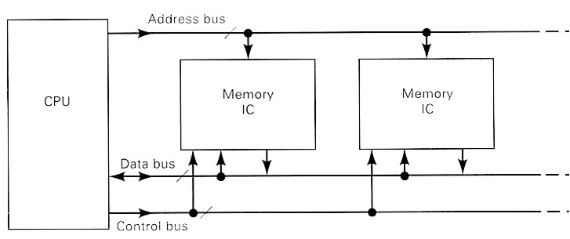
Memory
Memory is not a single chip (device)
  Made up of many identical or similar devices
  A specific device (part of memory) is selected by control signals and the address lines (bus)
  All devices are connected to the same bus, and see the signals at the same time

Slide 28
Memory
Memory Connection to CPU
  RAM and ROM chips are connected to a CPU through the data and address buses
  The low-order lines in the address bus select the byte within the chips and other lines in the address bus select a particular chip through its chip select inputs

Slide 29
Memory
Location - the smallest selectable unit in memory
  Has 1 or more data bits per location
  All bits in location are read/written together
  Cannot manipulate single bits in a location
For k address signals, there are 2^{k} locations in a memory device
Each location contains an n-bit word
Memory size is specified as
  loc x bits per location
    2²⁴ x 16 RAM - 2²⁴ = 16M words, each 16 bits long
    24 address lines, 16 data lines
  bits
    The total storage capacity is 2²⁴ x 16 = 2²⁸ bits

Slide 30
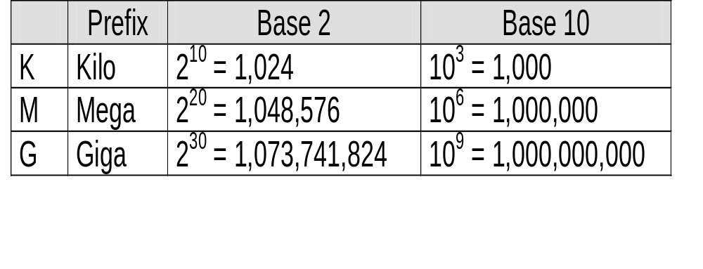
Memory
Memory sizes are usually specified in numbers of bytes (1 byte= 8 bits)
The 2²⁸-bit memory on the previous page translates into:
  2²⁸ bits / 8 bits per byte = 2²⁵ bytes
With the abbreviations below, this is equivalent to 32 megabytes

Slide 31
Semiconductor Memory
RAM
  Misnamed as all semiconductor memory is random access
  Read/Write
  Volatile
  Temporary storage
  Static or dynamic

Slide 32
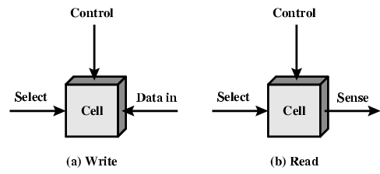
Memory Cell Operation

Slide 33
Dynamic RAM
Bits stored as charge in capacitors
Charges leak
Need refreshing even when powered
Simpler construction
Smaller per bit
Less expensive
Need refresh circuits
Slower
Main memory
Essentially analogue
  Level of charge determines value

Slide 34
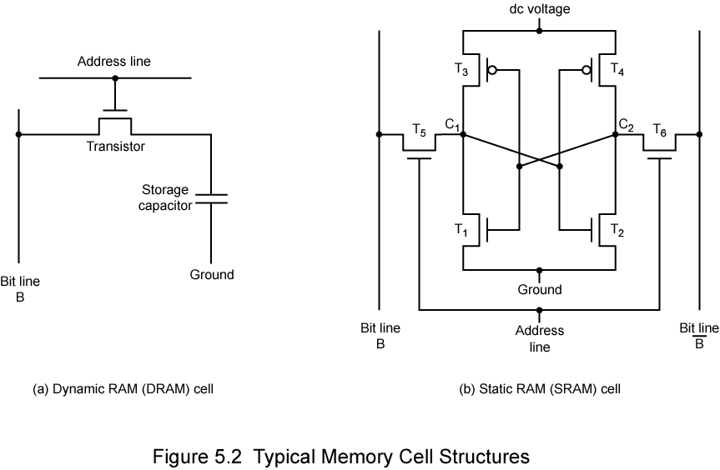
Dynamic RAM Structure

Slide 35
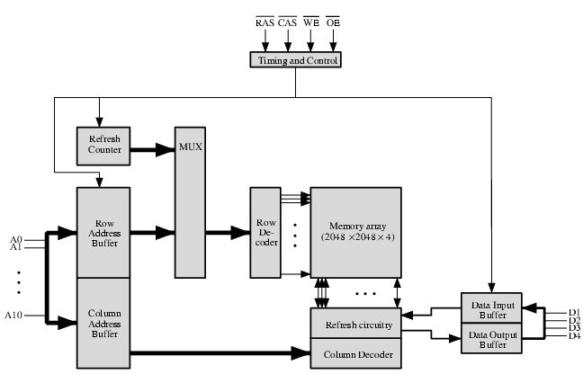
Typical 16 Mb DRAM (4M x 4)

Slide 36
DRAM Operation
Address line active when bit read or written
  Transistor switch closed (current flows)
Write
  Voltage to bit line
    High for 1 low for 0
  Then signal address line
    Transfers charge to capacitor
Read
  Address line selected
    transistor turns on
  Charge from capacitor fed via bit line to sense amplifier
    Compares with reference value to determine 0 or 1
  Capacitor charge must be restored

Slide 37
Static RAM
Bits stored as on/off switches
No charges to leak
No refreshing needed when powered
More complex construction
Larger per bit
More expensive
Does not need refresh circuits
Faster
Cache
Digital
  Uses flip-flops

Slide 38
Stating RAM Structure

Slide 39
Static RAM Operation
Transistor arrangement gives stable logic state
State 1
  C₁ high, C₂ low
  T₁ T₄ off, T₂ T₃ on
State 0
  C₂ high, C₁ low
  T₂ T₃ off, T₁ T₄ on
Address line transistors T₅ T₆ is switch
Write – apply value to B & compliment to B
Read – value is on line B

Slide 40
Advanced DRAM Organization
Basic DRAM same since first RAM chips
Enhanced DRAM
  Contains small SRAM as well
  SRAM holds last line read (c.f. Cache!)
Cache DRAM
  Larger SRAM component
  Use as cache or serial buffer

Slide 41
Synchronous DRAM (SDRAM)
Access is synchronized with an external clock
Address is presented to RAM
RAM finds data (CPU waits in conventional DRAM)
Since SDRAM moves data in time with system clock, CPU knows when data will be ready
CPU does not have to wait, it can do something else
Burst mode allows SDRAM to set up stream of data and fire it out in block
DDR-SDRAM sends data twice per clock cycle (leading & trailing edge)

Slide 42
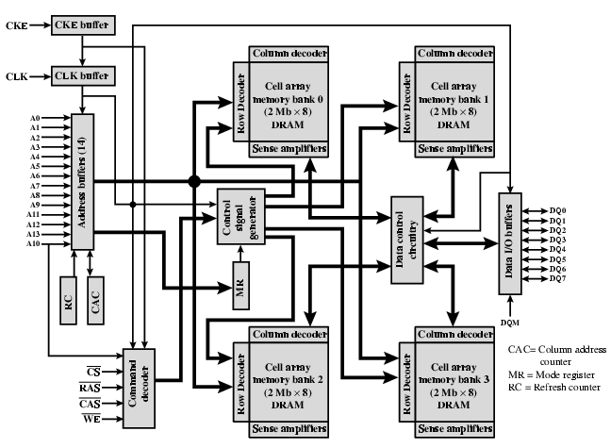
SDRAM

Slide 43
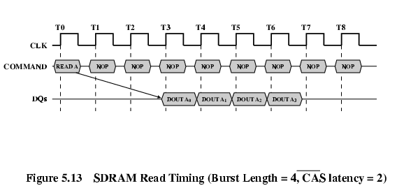
SDRAM Read Timing

Slide 44
RAMBUS
Adopted by Intel for Pentium & Itanium
Main competitor to SDRAM
Vertical package – all pins on one side
Data exchange over 28 wires < cm long
Bus addresses up to 320 RDRAM chips at 1.6Gbps
Asynchronous block protocol
  480ns access time
  Then 1.6 Gbps

Slide 45
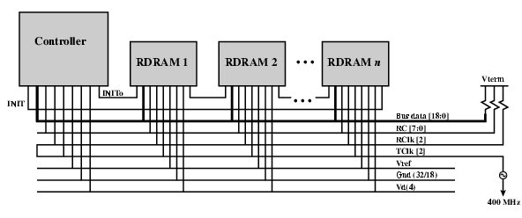
RAMBUS Diagram

Slide 46
DDR SDRAM
SDRAM can only send data once per clock
Double-data-rate SDRAM can send data twice per clock cycle
  Rising edge and falling edge

Slide 47
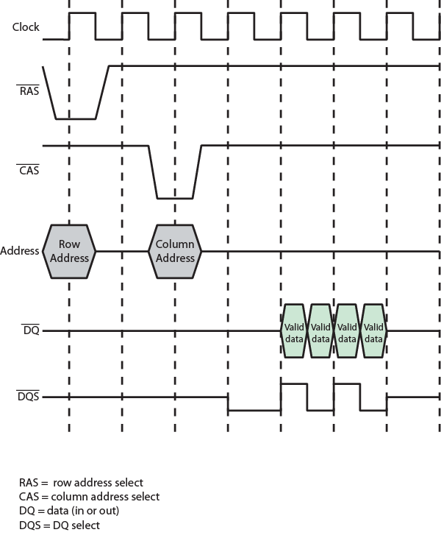
DDR SDRAM
Read Timing

Slide 48
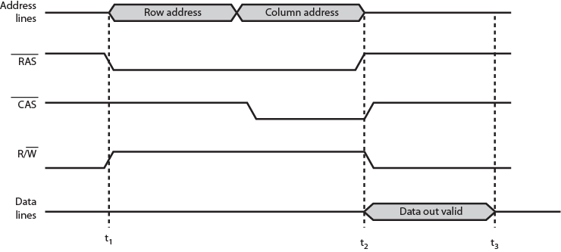
Simplified DRAM Read Timing

Slide 49
Cache DRAM
Mitsubishi
Integrates small SRAM cache (16 kb) onto generic DRAM chip
Used as true cache
  64-bit lines
  Effective for ordinary random access
To support serial access of block of data
  E.g. refresh bit-mapped screen
    CDRAM can prefetch data from DRAM into SRAM buffer
    Subsequent accesses solely to SRAM

Slide 50
SRAM v DRAM
Both volatile
  Power needed to preserve data
Dynamic cell
  Simpler to build, smaller
  More dense
  Less expensive
  Needs refresh
  Larger memory units
Static
  Faster
  Cache

Slide 51
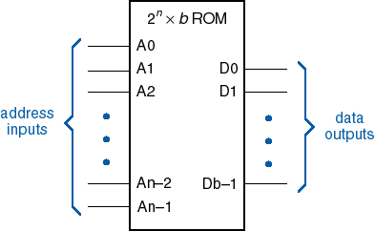
Read-Only Memories
The logic symbol below is used in circuit diagrams
  Focus is on the basic structure of a ROM
  A combinational logic circuit

Slide 52
Types of ROM
Volatile / non-volatile memory
ROM
PROM: programmable ROM
EPROM: erasable, reprogrammable ROM
EEPROM: can be programmed and erased electrically

Slide 53
PROM
PROM (Programmable Read-Only Memory) is a type of ROM that is written only.
It’s memory is written just the once and programmed electrically by the user at the time or when the initial chip fabrication.

Slide 54
EPROM
EPROM (Erasable Programmable Read-Only Memory) is a type of ROM that is read and written optically.
To write associate EPROM, its storage cells should stay within the same initial state.
EPROM provides reduced storage permanency as compared to PROM as a result of the EPROM being receptive to radiation and electrical noise.
In the construction of EPROM, MOS transistors are used.

Slide 55
Flash Memory
Similar to EEPROM
Difference: only possible to write an entire block of cells instead of a single cell
Low power
Use in portable equipment
Implementation of such modules
  Flash cards
  Flash drives

Slide 56
PROM vs EPROM
PROM | EPROM
PROM is not reusable. | EPROM is reusable multiple times.
PROM is inexpensive. | EPROM is costlier than PROM.
Writing to PROMS is irreversible, which means its memory is permanent. | EPROM’s processes can be reversed.
The storage endurance of PROM is high. | EPROM’s storage endurance of PROM is less than PROM.
PROM is a type of ROM that is written only. | EPROM is a type of ROM that is read and written optically.
If there’s a miscalculation or error or bug while writing on PROM, it becomes unusable. | If there’s a miscalculation or error or bug while writing on EPROM, it will still be used once more.
PROM is better than EPROM in terms of flexibility and scale. | EPROM has less flexibility and scalability.

Slide 57
Cache
Small amount of fast memory
Sits between normal main memory and CPU
May be located on CPU chip or module

Slide 58
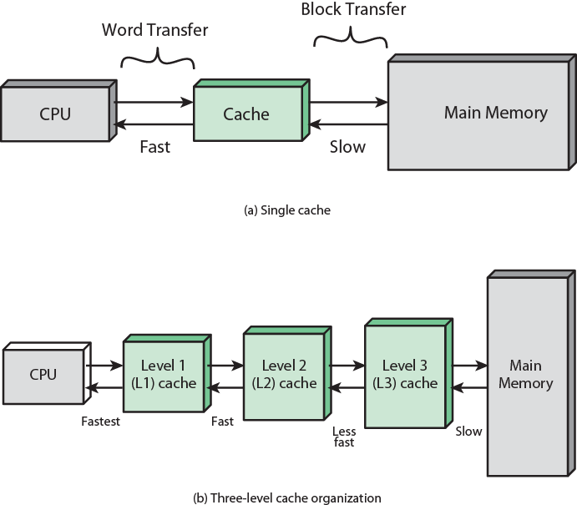
Cache and Main Memory

Slide 59
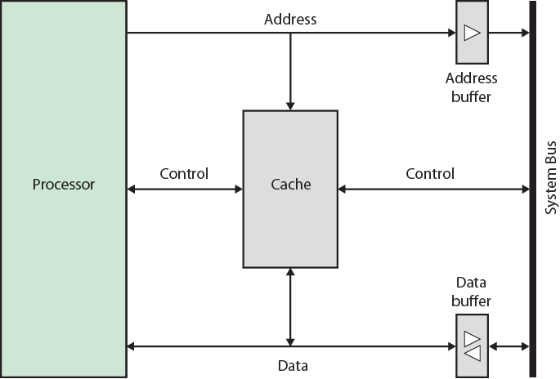
Typical Cache Organization

Slide 60
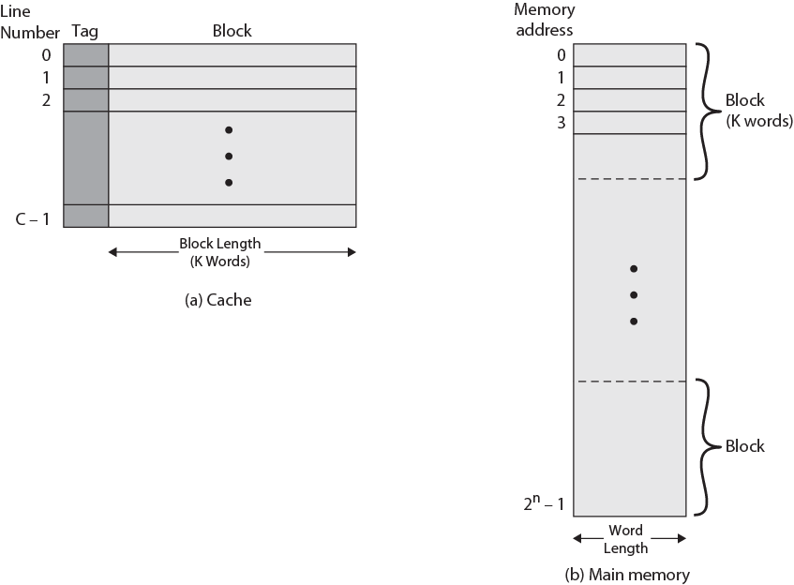
Cache/Main Memory Structure

Slide 61
Cache operation – overview
CPU requests contents of memory location
Check cache for this data
If present, get from cache (fast)
If not present, read required block from main memory to cache
Then deliver from cache to CPU
Cache includes tags to identify which block of main memory is in each cache slot

Slide 62
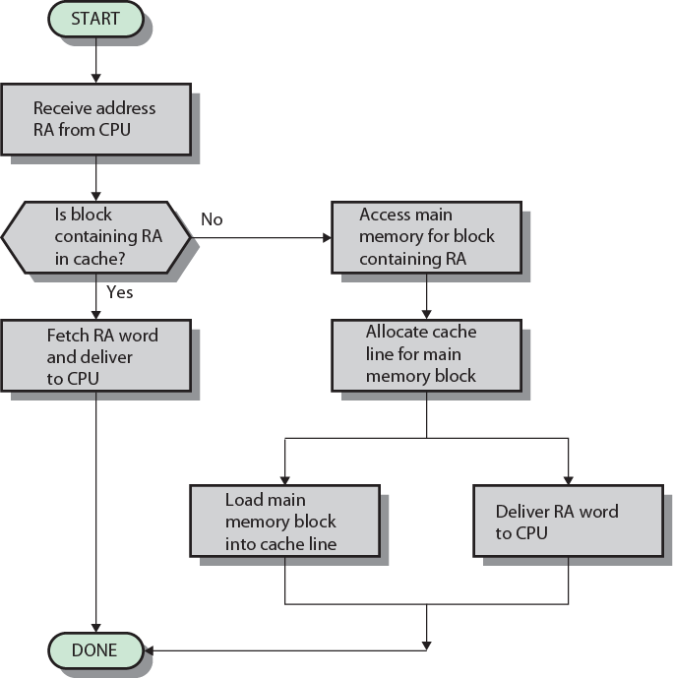
Cache Read Operation - Flowchart

Slide 63
Cache Design
Addressing
Size
Mapping Function
Replacement Algorithm
Write Policy
Block Size
Number of Caches

Slide 64
Cache Addressing
Where does cache sit?
  Between processor and virtual memory management unit
  Between MMU and main memory
Logical cache (virtual cache) stores data using virtual addresses
  Processor accesses cache directly, not thorough physical cache
  Cache access faster, before MMU address translation
  Virtual addresses use same address space for different applications
    Must flush cache on each context switch
Physical cache stores data using main memory physical addresses

Slide 65
Size does matter
Cost
  More cache is expensive
Speed
  More cache is faster (up to a point)
  Checking cache for data takes time

Slide 66
Comparison of Cache Sizes
Processor
Type
Year of Introduction
L1 cache
L2 cache
L3 cache
IBM 360/85
Mainframe
1968
16 to 32 KB
—
—
PDP-11/70
Minicomputer
1975
1 KB
—
—
VAX 11/780
Minicomputer
1978
16 KB
—
—
IBM 3033
Mainframe
1978
64 KB
—
—
IBM 3090
Mainframe
1985
128 to 256 KB
—
—
Intel 80486
PC
1989
8 KB
—
—
Pentium
PC
1993
8 KB/8 KB
256 to 512 KB
—
PowerPC 601
PC
1993
32 KB
—
—
PowerPC 620
PC
1996
32 KB/32 KB
—
—
PowerPC G4
PC/server
1999
32 KB/32 KB
256 KB to 1 MB
2 MB
IBM S/390 G4
Mainframe
1997
32 KB
256 KB
2 MB
IBM S/390 G6
Mainframe
1999
256 KB
8 MB
—
Pentium 4
PC/server
2000
8 KB/8 KB
256 KB
—
IBM SP
High-end server/ supercomputer
2000
64 KB/32 KB
8 MB
—
CRAY MTAb
Supercomputer
2000
8 KB
2 MB
—
Itanium
PC/server
2001
16 KB/16 KB
96 KB
4 MB
SGI Origin 2001
High-end server
2001
32 KB/32 KB
4 MB
—
Itanium 2
PC/server
2002
32 KB
256 KB
6 MB
IBM POWER5
High-end server
2003
64 KB
1.9 MB
36 MB
CRAY XD-1
Supercomputer
2004
64 KB/64 KB
1MB
—

Slide 67
Hit Rate and Miss Penalty
The success rate in accessing information at various levels of the memory hierarchy – hit rate / miss rate.
Ideally, the entire memory hierarchy would appear to the processor as a single memory unit that has the access time of a cache on the processor chip and the size of a magnetic disk – depends on the hit rate (>>0.9).
A miss causes extra time needed to bring the desired information into the cache.

Slide 68
Example Hit Ratio
Refer Word Document

Slide 69
How to Improve Hit Rate?
Use larger cache – increased cost
Increase the block size while keeping the total cache size constant.
However, if the block size is too large, some items may not be referenced before the block is replaced – miss penalty increases.
Load-through approach

Slide 70
Mapping Function
Cache of 64kByte
Cache block of 4 bytes
  i.e. cache is 16k (2¹⁴) lines of 4 bytes
16MBytes main memory
24 bit address
  (2²⁴=16M)

Slide 71
Direct Mapping
Each block of main memory maps to only one cache line
  i.e. if a block is in cache, it must be in one specific place
Address is in two parts
Least Significant w bits identify unique word
Most Significant s bits specify one memory block
The MSBs are split into a cache line field r and a tag of s-r (most significant)

Slide 72
Direct Mapping
Address Structure
Tag s-r
Line or Slot r
Word w
8
14
2
24 bit address
2 bit word identifier (4 byte block)
22 bit block identifier
  8 bit tag (=22-14)
  14 bit slot or line
No two blocks in the same line have the same Tag field
Check contents of cache by finding line and checking Tag

Slide 73
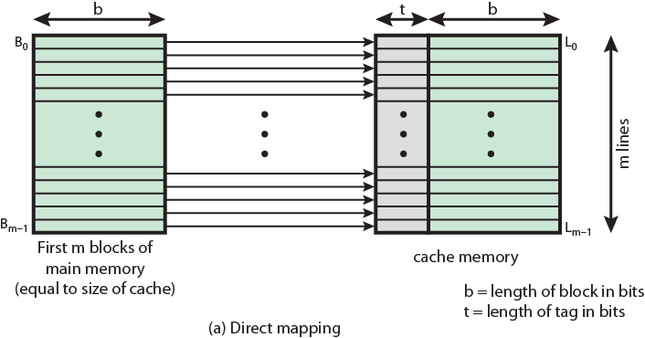
Direct Mapping from Cache to Main Memory

Slide 74
Direct Mapping
Cache Line Table
Cache line | Main Memory blocks held
0 | 0, m, 2m, 3m…2s-m
1 | 1,m+1, 2m+1…2s-m+1
…
m-1 | m-1, 2m-1,3m-1…2s-1

Slide 75
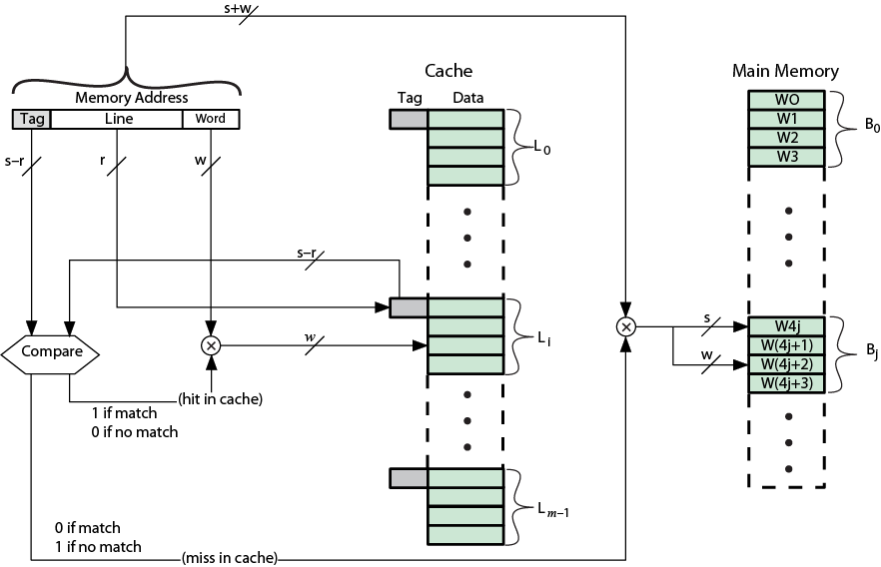
Direct Mapping Cache Organization

Slide 76
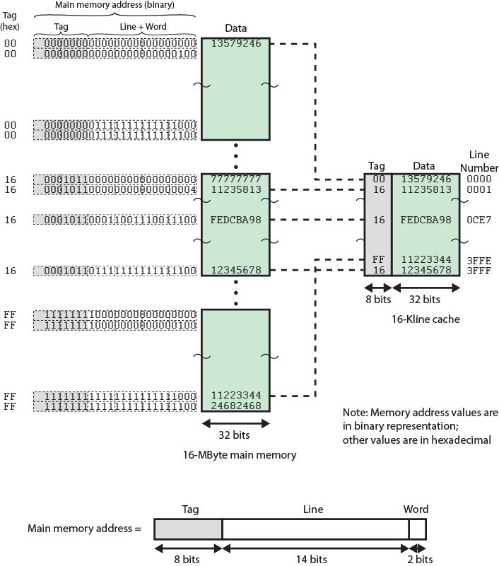
Direct
Mapping
Example

Slide 77
Direct Mapping Summary
Address length = (s + w) bits
Number of addressable units = 2s+w words or bytes
Block size = line size = 2w words or bytes
Number of blocks in main memory = 2s+ w/2w = 2s
Number of lines in cache = m = 2r
Size of tag = (s – r) bits

Slide 78
Direct Mapping pros & cons
Simple
Inexpensive
Fixed location for given block
  If a program accesses 2 blocks that map to the same line repeatedly, cache misses are very high

Slide 79
Victim Cache
Lower miss penalty
Remember what was discarded
  Already fetched
  Use again with little penalty
Fully associative
4 to 16 cache lines
Between direct mapped L1 cache and next memory level

Slide 80
Associative Mapping
A main memory block can load into any line of cache
Memory address is interpreted as tag and word
Tag uniquely identifies block of memory
Every line’s tag is examined for a match
Cache searching gets expensive

Slide 81
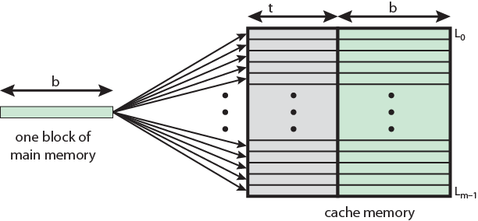
Associative Mapping from
Cache to Main Memory

Slide 82
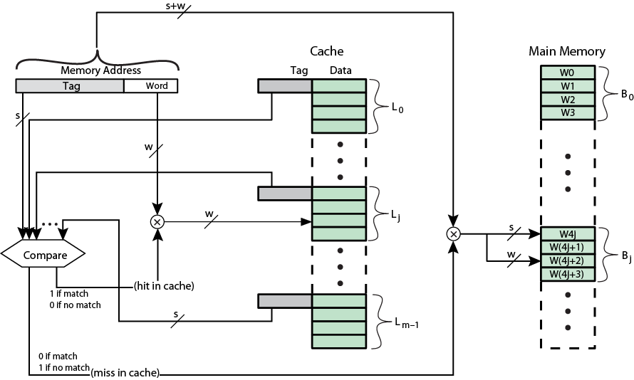
Fully Associative Cache Organization

Slide 83
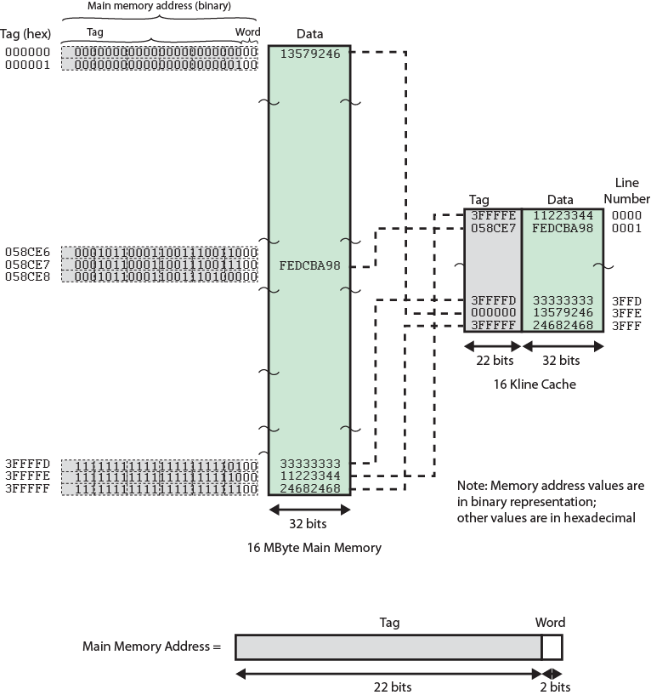
Associative
Mapping
Example

Slide 84
Associative Mapping
Address Structure
Word
2 bit
Tag 22 bit
22 bit tag stored with each 32 bit block of data
Compare tag field with tag entry in cache to check for hit
Least significant 2 bits of address identify which 16 bit word is required from 32 bit data block
e.g.
  Address Tag Data Cache line
  FFFFFC FFFFFC 24682468 3FFF

Slide 85
Associative Mapping Summary
Address length = (s + w) bits
Number of addressable units = 2s+w words or bytes
Block size = line size = 2w words or bytes
Number of blocks in main memory = 2s+ w/2w = 2s
Number of lines in cache = undetermined
Size of tag = s bits

Slide 86
Set Associative Mapping
Cache is divided into a number of sets
Each set contains a number of lines
A given block maps to any line in a given set
  e.g. Block B can be in any line of set i
e.g. 2 lines per set
  2 way associative mapping
  A given block can be in one of 2 lines in only one set

Slide 87
Set Associative Mapping
Example
13 bit set number
Block number in main memory is modulo 2¹³
000000, 00A000, 00B000, 00C000 … map to same set

Slide 88
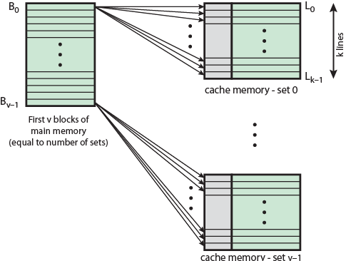
Mapping From Main Memory to Cache: v Associative

Slide 89
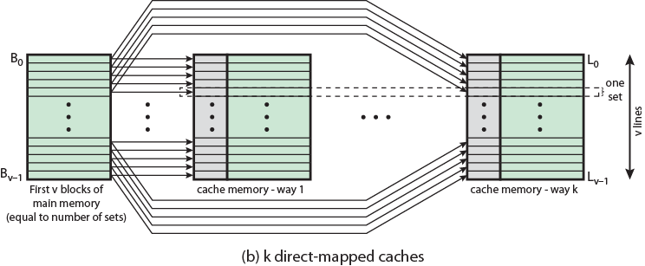
Mapping From Main Memory to Cache: k-way Associative

Slide 90
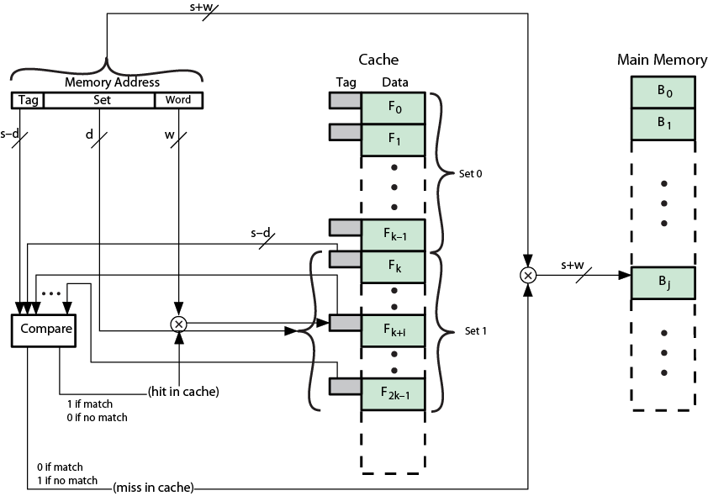
K-Way Set Associative Cache Organization

Slide 91
Set Associative Mapping
Address Structure
Word
2 bit
Tag 9 bit
Set 13 bit
Use set field to determine cache set to look in
Compare tag field to see if we have a hit
e.g
  Address Tag Data Set number
  1FF 7FFC 1FF 12345678 1FFF
  001 7FFC 001 11223344 1FFF

Slide 92
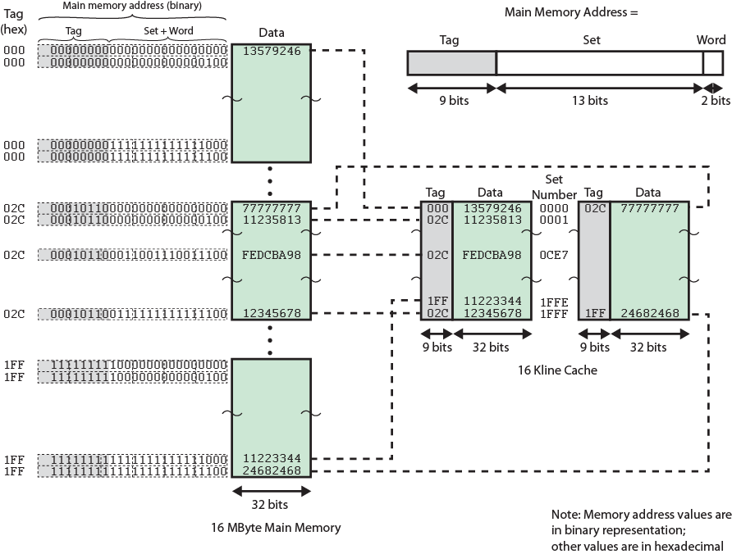
Two Way Set Associative Mapping Example

Slide 93
Set Associative Mapping Summary
Address length = (s + w) bits
Number of addressable units = 2s+w words or bytes
Block size = line size = 2w words or bytes
Number of blocks in main memory = 2d
Number of lines in set = k
Number of sets = v = 2d
Number of lines in cache = kv = k * 2d
Size of tag = (s – d) bits

Slide 94
Direct and Set Associative Cache
Performance Differences
Significant up to at least 64kB for 2-way
Difference between 2-way and 4-way at 4kB much less than 4kB to 8kB
Cache complexity increases with associativity
Not justified against increasing cache to 8kB or 16kB
Above 32kB gives no improvement
(simulation results)

Slide 95
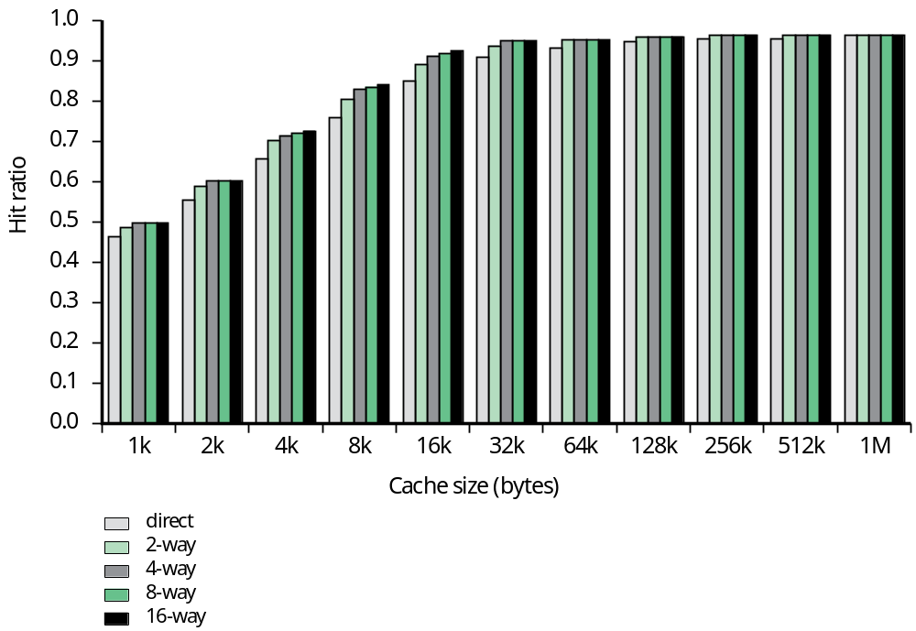
Figure 4.16
Varying Associativity over Cache Size

Slide 96
Virtual Memory
Physical main memory is not as large as the address space spanned by an address issued by the processor.
2³² = 4 GB, 2⁶⁴ = …
When a program does not completely fit into the main memory, the parts of it not currently being executed are stored on secondary storage devices.
Techniques that automatically move program and data blocks into the physical main memory when they are required for execution are called virtual-memory techniques.
Virtual addresses will be translated into physical addresses.

Slide 97
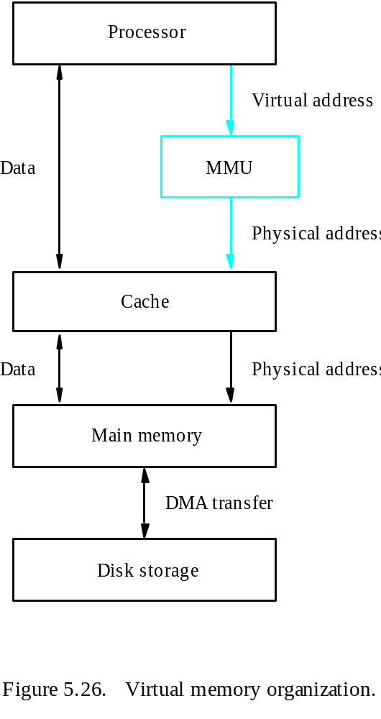
Overview
Memory Management Unit

